Slide 1
PROCEDURAL JUSTICE FOR PROSECUTORS
[DATE]
[FACILITATOR]
INSERT ORGANIZATION
LOGO HERE

Slide 2
INTRODUCTIONS
TRAINING GROUND RULES
Be respectful and honest
Judgment free zone
Step up & step back
Speak and listen with respect
Be present
Take care of yourself
Confidentiality
Mics off ears open
Be camera ready
INSERT ORGANIZATION MISSION STATEMENT
INSERT FACILITATOR NAME(S)
TITLE (PHOTO OPTIONAL)

Slide 3
TRAINING OBJECTIVES
Module 1: Discussion of the role of a prosecutor
15 min Break
Module 2: Understanding the underpinnings of Procedural Justice theory and its applicability to office culture
15 min Break
Module 3: Simulated application of Procedural Justice (breakout groups)
Recap/ Q+A

Slide 4
WARNING!
These videos may be disturbing to some and may make others uncomfortable.

Slide 6
HOW DOES THIS VIDEO RELATE TO YOUR JOB AS A PROSECUTOR?
“The negotiation of a plea bargain, rather than the unfolding of a trial, is almost always the critical point for a defendant…It is the criminal justice system.”
– Justice Anthony Kennedy

Slide 8
DOES THIS VIDEO CHANGE YOUR ANSWER?
“Policing and prosecution go hand in hand.”
– Kim Foxx, Cook County State’s Attorney

Slide 9
WHAT IS A PROSECUTOR?

Slide 10
ABA Rule 3.8:
Special Responsibilities Of A Prosecutor
“The prosecutor is an administrator of justice, a zealous advocate, and an officer of the court.”

Slide 11
ADMINISTRATOR
LEGITIMACY
ADVOCATE
OFFICER

Slide 12
“Views about legitimacy are rooted in the judgment that the police and the courts are acting fairly when they deal with community residents.”
- Tom Tyler

Slide 13
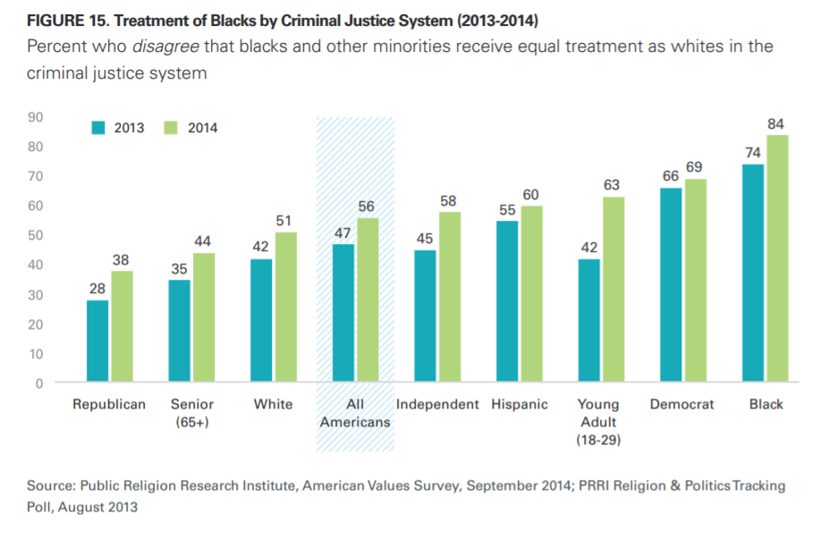

Slide 14
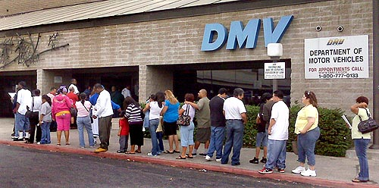

Slide 15
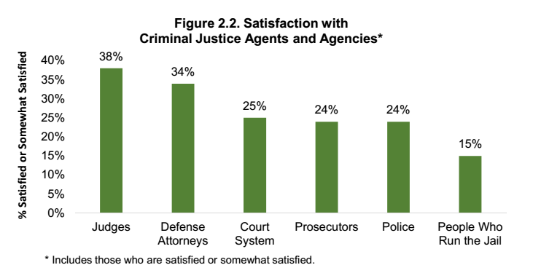
Source: Swaner, Rachel, Rachel Swaner, Cassandra Ramdath, Andrew Martinez, Josephine Hahn, and Sienna Walker. “What Do Defendants Really Think?” Center for Court Innovation, September 1, 2018.

Slide 17
PUBLIC TRUST MATTERS
15% reported having “a great deal” or “quite a lot”
of confidence in the criminal justice system
Source: book of criminal justice statistics online, http://www.albany.edu/sourcebook/pdf/t2102012.pdf

Slide 18
TAKEAWAY
What is one thing that moved or struck you?
What is one thing you’re going to pass down to your staff?

Slide 19
PROCEDURAL JUSTICE FOR PROSECUTORS
15 MIN BREAK

Slide 20
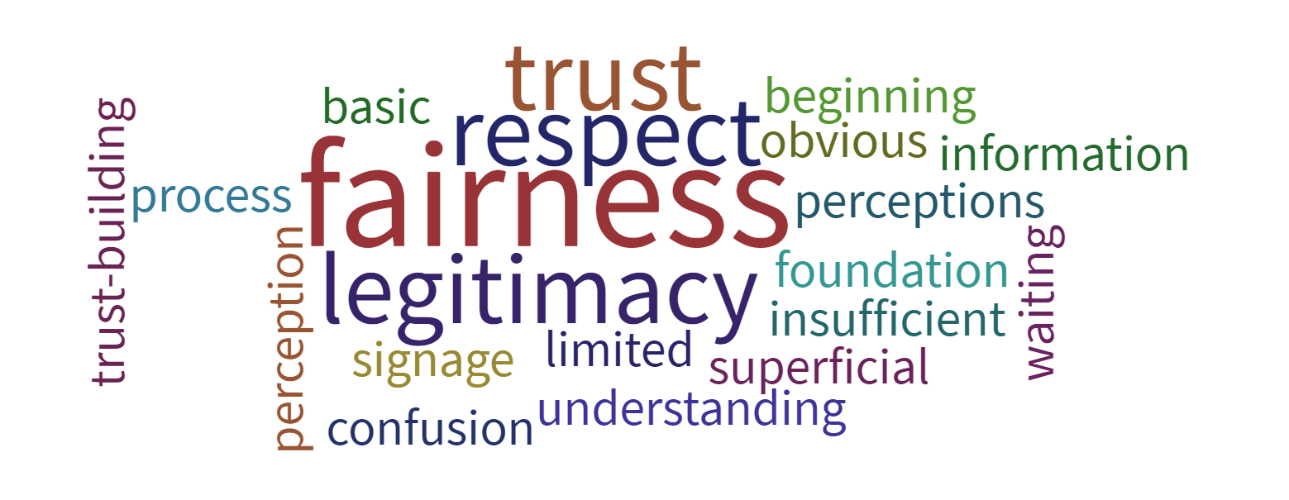
WHAT IS
PROCEDURAL JUSTICE?

Slide 21
ELEMENTS OF PROCEDURAL JUSTICE
RESPECT
VOICE
NEUTRALITY
UNDERSTANDING

Slide 22
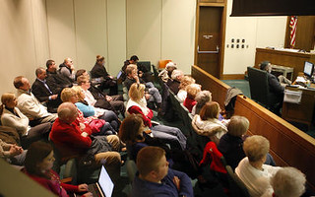
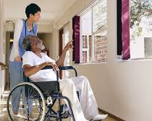
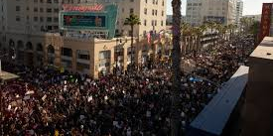
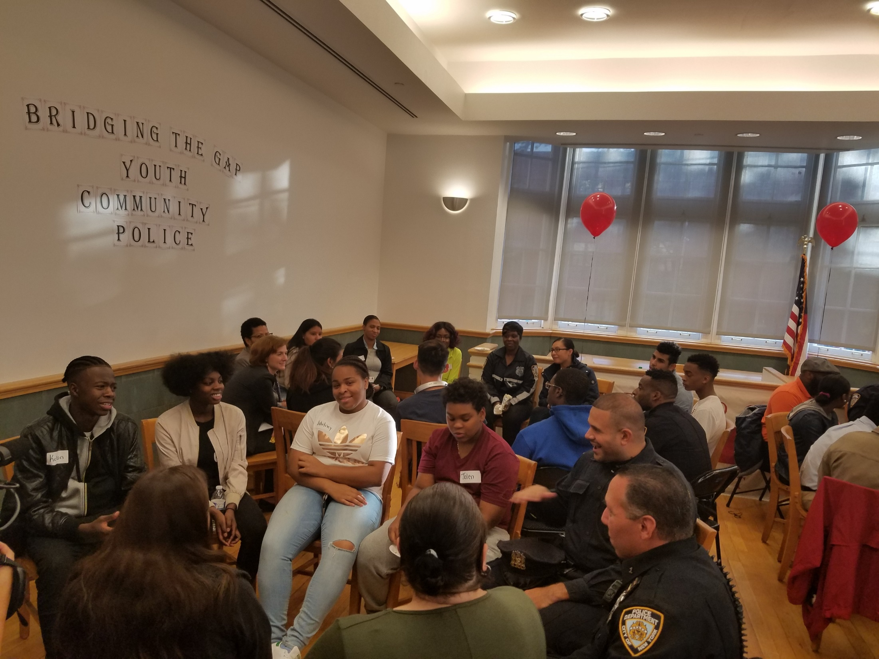
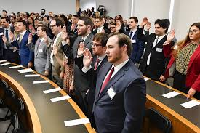
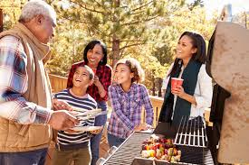
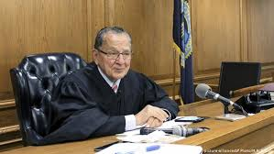
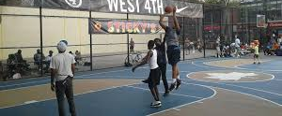
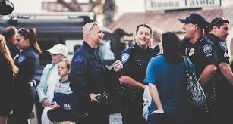
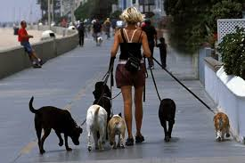
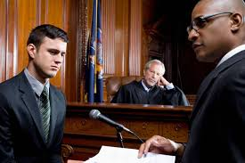
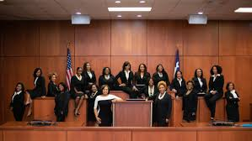
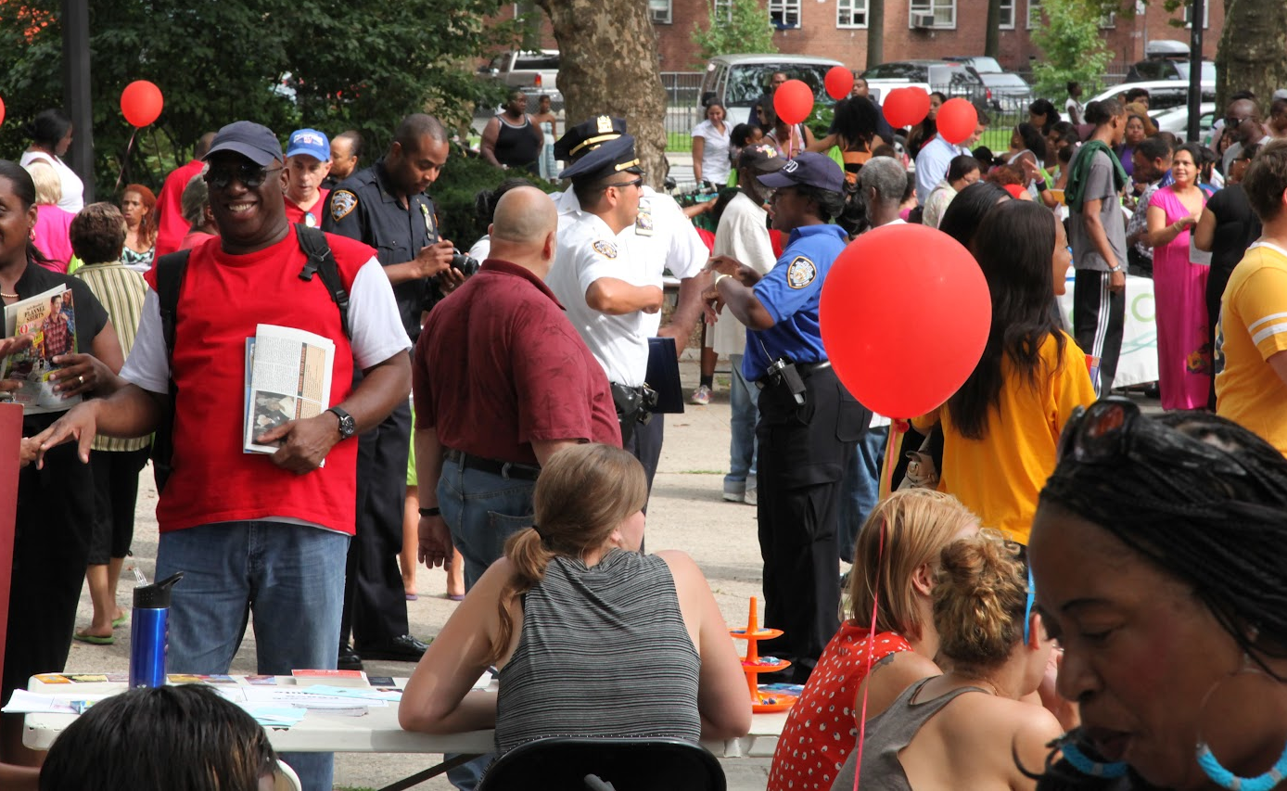
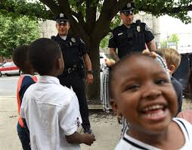
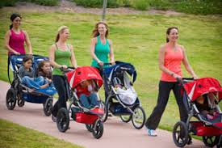
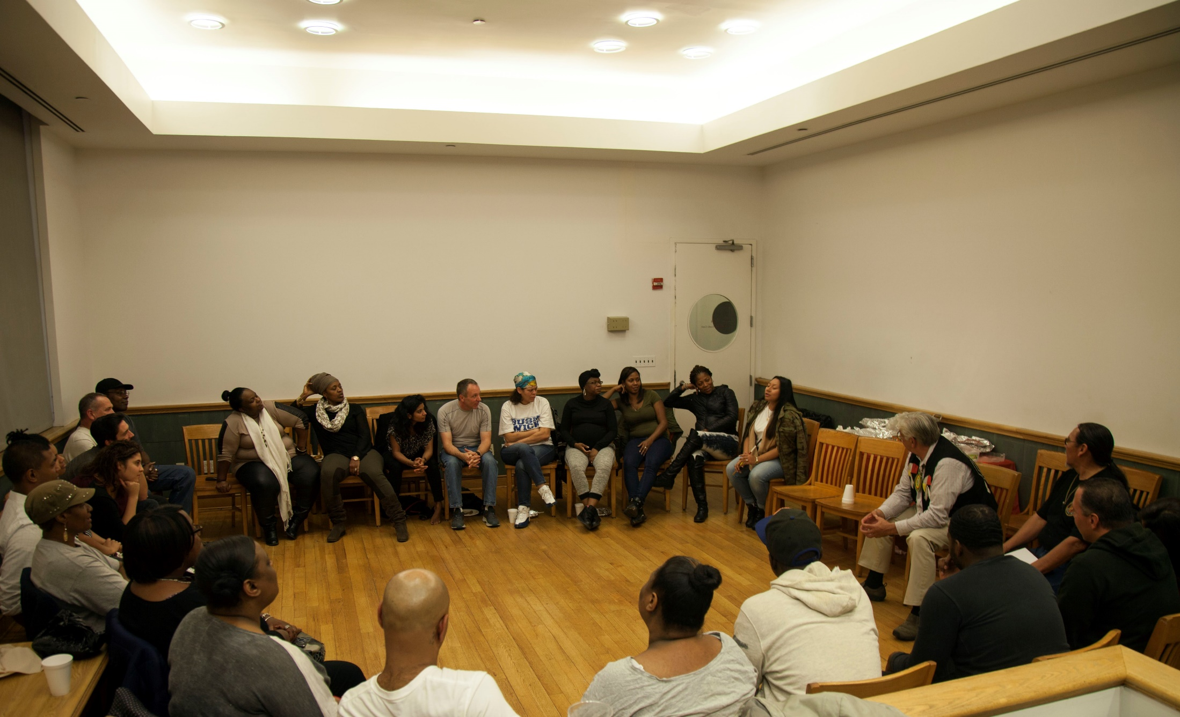

Slide 23
BENEFITS OF PROCEDURAL JUSTICE
Public trust in the justice system
Likelihood of reporting future crimes
Cooperation with law enforcement
Court appearance rates
Compliance with court orders and the law
Understanding of legal process and expectations

Slide 24
BENEFITS OF PROCEDURAL JUSTICE
IF Procedural Fairness, THEN Increased Decision Acceptance

Slide 25
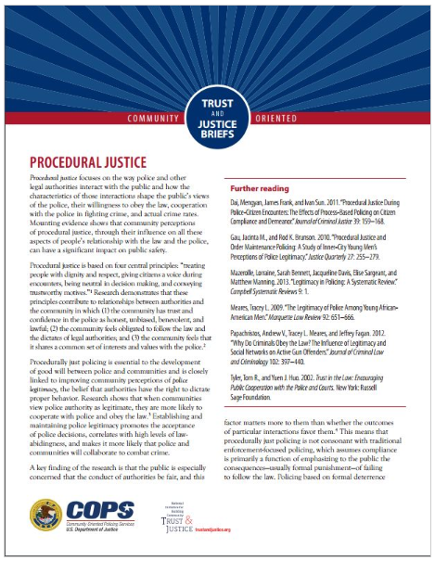
National Initiative for Building Community Trust & Justice
Increased perceptions of procedural justice
Increased perceptions of legitimacy
Increased willingness to partner with police
Decreased perceptions of racial bias
Decreased use of force

Slide 26
SERVICE INDUSTRY
Increased customer satisfaction with both the process and outcome.
Increased customer satisfaction with the treatment received and the outcome.

Slide 27
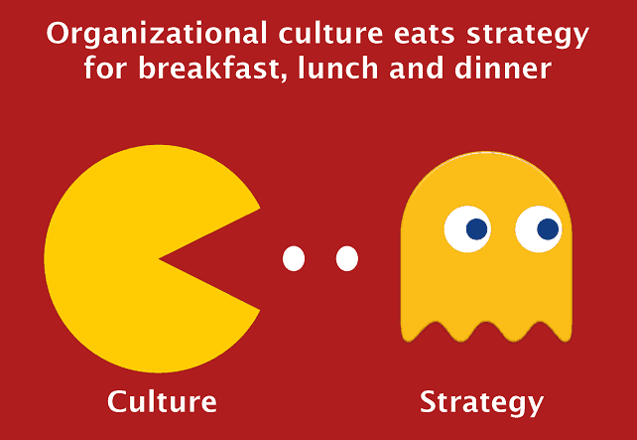
Procedural Justice and Office Culture

Slide 28
ELEMENT 1: RESPECT
Perception that the judge, attorneys, and court staff treat individuals with dignity and respect.
“Procedural Justice for Prosecutors
is what we say and how we act towards accused people when they’re not around.”
-- Former ADA, DANY
Victims/Witnesses
The Accused
The Community

Slide 29
ELEMENT 1: RESPECT
Perception that the judge, attorneys, and court staff treat individuals with dignity and respect.
THE VICTIM/WITNESS
THE ACCUSED
THE COMMUNITY
Interview victims/witnesses in a comfortable and safe environment
Limit the number of times a victim/witness is asked to recount events
Attend community events in your role as a prosecutor
Learn the community’s history
Support CBOs in your jurisdiction and the services they provide
Stop using the term “defendant”
Don’t read unnecessary incendiary details at arraignments
Look at the accused when they are before the court

Slide 30
ELEMENT 2: VOICE
Perception that the individual’s side of the story has been heard.
“Too often justice-involved people don’t have a chance to speak…An important part of procedural justice is making space for participants to explain their side of the story.”
-- Former ADA, Maricopa County
Victims/Witnesses
The Accused
The Community

Slide 31
ELEMENT 2: VOICE
Perception that the individual’s side of the story has been heard.
THE VICTIM/WITNESS
THE ACCUSED
THE COMMUNITY
Ask victims whether they feel comfortable discussing the incident over the phone before you start inquiry
Do not lead the victim/witness when they recount the incident
Ask the defense attorney (or accused, if pro se) whether they have information you should consider
Routinely ask for community feedback about the policies and practices of your office

Slide 32
ELEMENT 3: NEUTRALITY
Perception that the decision-making process is unbiased and trustworthy.
“It is so important that prosecutors are seen...evaluating and prosecuting each case in a neutral, unbiased way. Our behavior in and out of the courtroom can have a huge effect on this perception.”
-- Former ADA, KCDA
Victims/Witnesses
The Accused
The Community

Slide 33
ELEMENT 3: NEUTRALITY
Perception that the decision-making process is unbiased and trustworthy.
THE VICTIM/WITNESS
THE ACCUSED
THE COMMUNITY
Do not use accusatory language
Do not make assumptions about a victim’s or witness’ lived experience
Consistent courtroom decorum on and off the record with all parties
Offer consistent offers, especially when an ATI is not an option
Provide information on decision-making for high-profile cases
Make office policies public in order to be held accountable by the community

Slide 34
ELEMENT 4: UNDERSTANDING
Individual’s comprehension of their rights, the process, and how decisions are made.
“Procedural justice is providing participants with the opportunity to be fully part of the process so that they can make informed decisions.”
-- Former ACA, Los Angeles City Attorney’s Office
Victims/Witnesses
The Accused
The Community

Slide 35
ELEMENT 4: UNDERSTANDING
Individual’s comprehension of their rights, the process, and how decisions are made.
THE VICTIM/WITNESS
THE ACCUSED
THE COMMUNITY
Show the victim or witness that you heard them and ask if your understanding is accurate.
Provide the victim or witness with step-by-step information on what to expect when navigating the system
Provide defense attorneys with discovery as soon as possible
Candidly explain reason for not being ready for trial
Provide defense attorney with reason when ATI is not available
Provide opportunities for community to understand how the criminal justice system works
Openly share data on case dispositions and use of diversion/ATI with community

Slide 36
TAKEAWAY
Take 5 minutes and write down your commitment to practice each of the elements: respect, voice, neutrality, and understanding.

Slide 37
PROCEDURAL JUSTICE FOR PROSECUTORS
15 MIN BREAK

Slide 38
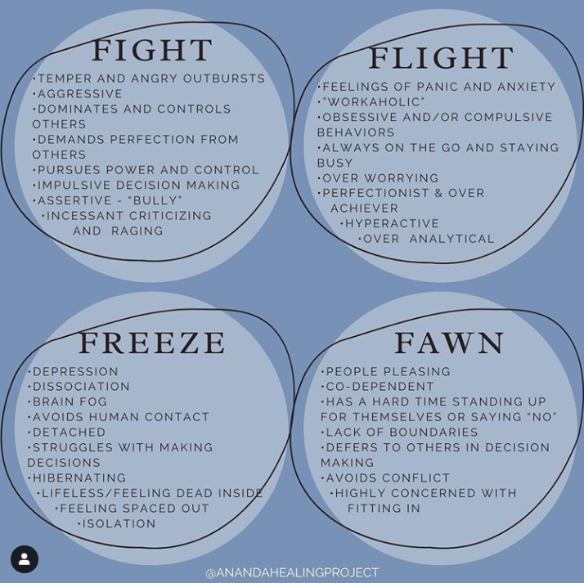
We must acknowledge that trauma responses are mechanisms to keep ourselves safe. Even when those decisions to remain safe break laws in place.

Slide 39
Combining Procedural Justice with trauma-informed practices
Operate under a universal expectation of trauma
anyone in any system or program, no matter their position, whether they are people who use services or staff, can be a trauma survivor
Identify how your own values, biases, and “hot spots” affect your behavior and communication
Rely on the tools at your disposal and your relationships with court parties

Slide 40
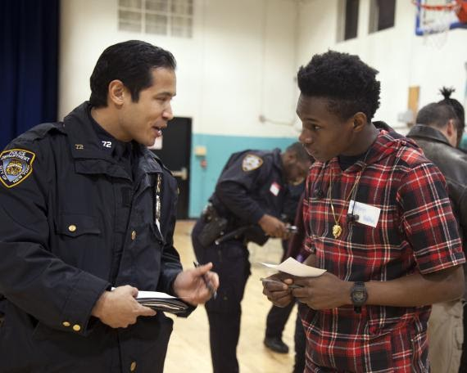
Juveniles and Young Adults
Among juvenile respondents surveyed after first appearance and sentencing:
What % did not know they were represented by counsel?
3 out of 10
What % of release and sentence conditions did they remember?
1 out of 3
Source: Washington Judicial Colloquies Project
Source: TED Blog
The pre-frontal cortex (responsible for decision making) is not fully developed until 25 years old!

Slide 41
Juveniles and Young Adults
RESPECT
Do not make assumptions about a young person because of their criminal or family court history, where they live, or what affiliations they may have
VOICE
VOICE
Collaborate with defense attorneys to determine the best disposition
NEUTRALITY
Explain decision making processes where co-accuseds receive differing supervision and/or alternative options
UNDERSTANDING
Ensure that the young person fully understands the parameters of their supervision and/or jail alternative

Slide 42
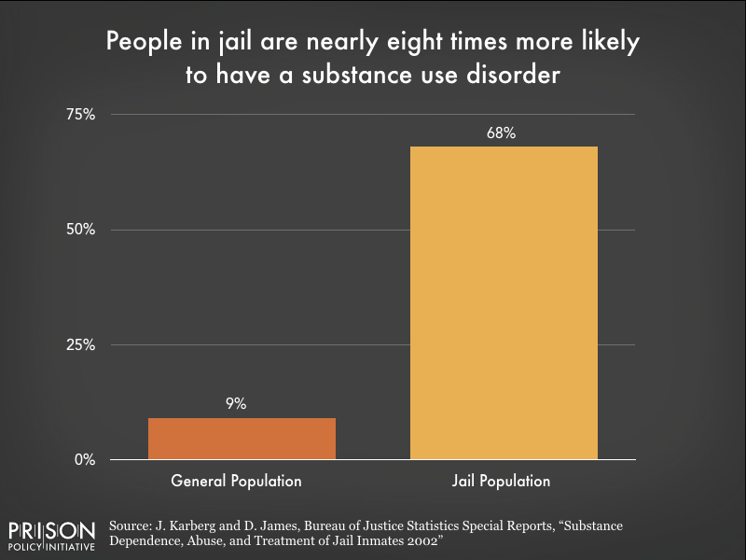
Substance Use Disorders
20% of the jail population don't meet criteria for a SUD diagnosis, but were under the influence when crime was committed (NIDA)
More likely to need services that address key health determinants rather than a treatment mandate
Not everyone who is justice-involved and uses illegal drugs has an SUD or needs treatment!

Slide 43
Substance Use Disorders
RESPECT
Use non-stigmatizing language; trauma-informed tone and demeanor ​
Avoid language that disparages drug use or drug-using communities as it will often evoke pushback or resistance
VOICE
VOICE
Avoid treating litigants with SUD as inherently untrustworthy or “in denial” about their use
SUD treatment planning is always more successful when collaborative; ensure litigant POV is valued​
NEUTRALITY
Interrogate personal beliefs regarding substance use
Avoid punishing litigants for perceived unwillingness or ambivalence about changing their substance use
UNDERSTANDING
Ensure litigants are fully aware of the court’s expectations re their substance use and treatment progress by creating a clear record in court

Slide 44
BREAKOUT SESSION

Slide 45
Courtroom Scenario 1
You are working a busy arraignment shift. A person is being charged with aggravated assault of an intimate partner. When addressing the court:
Do you call the accused “Mr./Ms.______” or “Defendant”?
Does your answer change if you know the person’s family is in the courtroom?
Does your answer change if the accused has multiple prior convictions for similar acts against the same person?

Slide 46
Courtroom Scenario 2
You are picking a jury and want to make sure the jury knows how ‘dangerous’ the accused is, in your opinion.
Do you call the accused “Mr./Ms.______” or “the Defendant”?
Does your answer change if you know the person’s family is in the courtroom?
What is the effect of calling the accused “the defendant”?
What is lost by calling the accused by their name?

Slide 47
Courthouse Scenario 1
You are working arraignments and step out of the courtroom for a moment. As soon as you enter the hallway, a woman who is visibly distraught approaches you and tells you her son was just arraigned (you were the prosecutor of record) and bail was set. She says this is her first time ever being in a courtroom and has no idea where her son is going or when his next court date is and asks if you can give her any information.
What information, if any, would you share with her?
How would you handle this situation if the woman was angry and aggressive when speaking with you?

Slide 48
Courthouse Scenario 2
You are about to enter a courtroom where only misdemeanor cases are heard, and a young man stops you. He has a warrant, is afraid to go into the courtroom, and doesn’t know what to do.
What do you tell the young man?
Would your response differ if the courtroom you were about to enter only handled felony cases?

Slide 49
Office Scenario 1
You are walking back to your office after spending the morning waiting for a trial to start. Your colleague makes a racially disparaging comment about one of accused men in your case.
What do you say to your colleague?
Does your response depend on your colleague’s racial background? Why or why not?

Slide 50
Office Scenario 2
A junior prosecutor in your bureau won their first trial and the conviction carries a mandatory prison sentence. They stop by your office and excitedly tell you they are going to celebrate the big win at the local bar and would like you to join.
How do you respond?
Should a mandatory prison sentence be celebrated? Why or why not?

Slide 51
Law Enforcement Scenario 1
A junior prosecutor is prepping their first felony trial, the result of a longstanding feud between the accused and victim. A supervisor has assigned to second seat the trial is present during prep with the arresting officer. During prep the officer says he is looking forward to “putting this animal away.”
What should you do as the junior prosecutor in this situation?
Does the possibility of offending a key witness impact your decision on how to respond to the officer?
Does the action or inaction of the senior prosecutor influence your decision? If so, how?
As the senior prosecutor, what should you do?
How do you use this as a moment to model the office’s mission to both the junior prosecutor and the officer?

Slide 52
Law Enforcement Scenario 2
You are the senior attorney in night arraignments on Saturday night and are about to arraign your twentieth case. As paperwork is being passed to the judge the bridge officer says “just a heads up, the next character has a lot of family in the court so be careful about what you say. You know how those people are and we don’t want to have to deal with them acting crazy in the hallways.” The bridge officer’s comments were loud enough to be heard by the rookie prosecutor shadowing you, the defense attorney, court reporter, and the judge.
How do you respond to the bridge officer?
Assume you chose not to respond, and the rookie prosecutor asks why you didn’t say anything. What do you tell him/her?
How does the bridge officer’s comment affect how you proceed with the arraignment?

Slide 53
Complaint Room Scenario 1
During one of your first shifts in the complaint room, you write up a misdemeanor assault resulting from a fight between two 19-year-old men. There is an 18-yo co-accused charged with acting in concert, who was not a direct participant in the fight. You are not clear what the reason was for this arrest and begin to question the arresting officer to determine whether there was probable cause for the 18-year old’s arrest. The officer gets annoyed by your questions and blurts out, “What’s the big deal here? Just write it up as I told you and let the courts sort it all out.”
Should you respond to the officer?
If so, what would you say?
Would you consult with a supervisor before responding to the officer?

Slide 54
Complaint Room Scenario 2
During your first night shift in the complaint room, you are writing up a petit larceny where a woman was stealing baby formula from a local drug store. When you take the complaint to your supervisor for approval, he tells you to add a robbery charge since the accused used force when pushing past the security officer. You were hoping to convince your supervisor to decline to prosecute because you do not believe that the facts of this case warrant a felony charge.
How do you respond to your supervisor?
What do you do if your supervisor tells you to continue drafting the complaint as instructed?

Slide 56
PROCEDURAL JUSTICE FOR PROSECUTORS
THANK YOU!

