Slide 1
Prosecutor Well-Being
Produced by The Institute for Innovation in Prosecution

Slide 2
Prosecutor Well-Being

Slide 3
This workshop is about well-being in the prosecution work environment. It is not mental health treatment. Please seek out professional help from a mental health practitioner via your employee assistance program if you are experiencing any distressing thoughts, feelings or symptoms.
Prosecutor Well-Being

Slide 4
Objectives
Suggest that tending to prosecutor well-being is the most accessible criminal justice reform that you can individually implement today
Define “well-being” as it relates to prosecutors
Discuss the connection between well-being and ethics for prosecutors
Demonstrate that attention to prosecutor well-being is critical to support fair case adjudication and reduce attrition
Identify the signs and consequences of not investing in well-being
Define six areas of well-being and provide practical guidance to support them
Prosecutor Well-Being

Slide 5
Exercise
Name three traits that make a good prosecutor.
Prosecutor Well-Being

Slide 6
“We can sustain our work with trauma only if we combine our capacity for empathy with a dedication to personal insight and mindfulness.”
Trauma Stewardship, Laura van Dernoot Lipsky
Prosecutor Well-Being

Slide 7
Lawyer Well-Being
2016 study by the American Bar Association and Hazeldon Betty Ford Foundation found:
between 21 and 36% practicing lawyers qualify as problem drinkers
28% struggle with depression
19% struggle with anxiety
23% struggle with stress
Highest rates of problem drinking and depression found in
Lawyers in the first 10 years of their career
Lawyers working at firms
Many lawyers felt “profound ambivalence” about their work
Prosecutor Well-Being

Slide 8
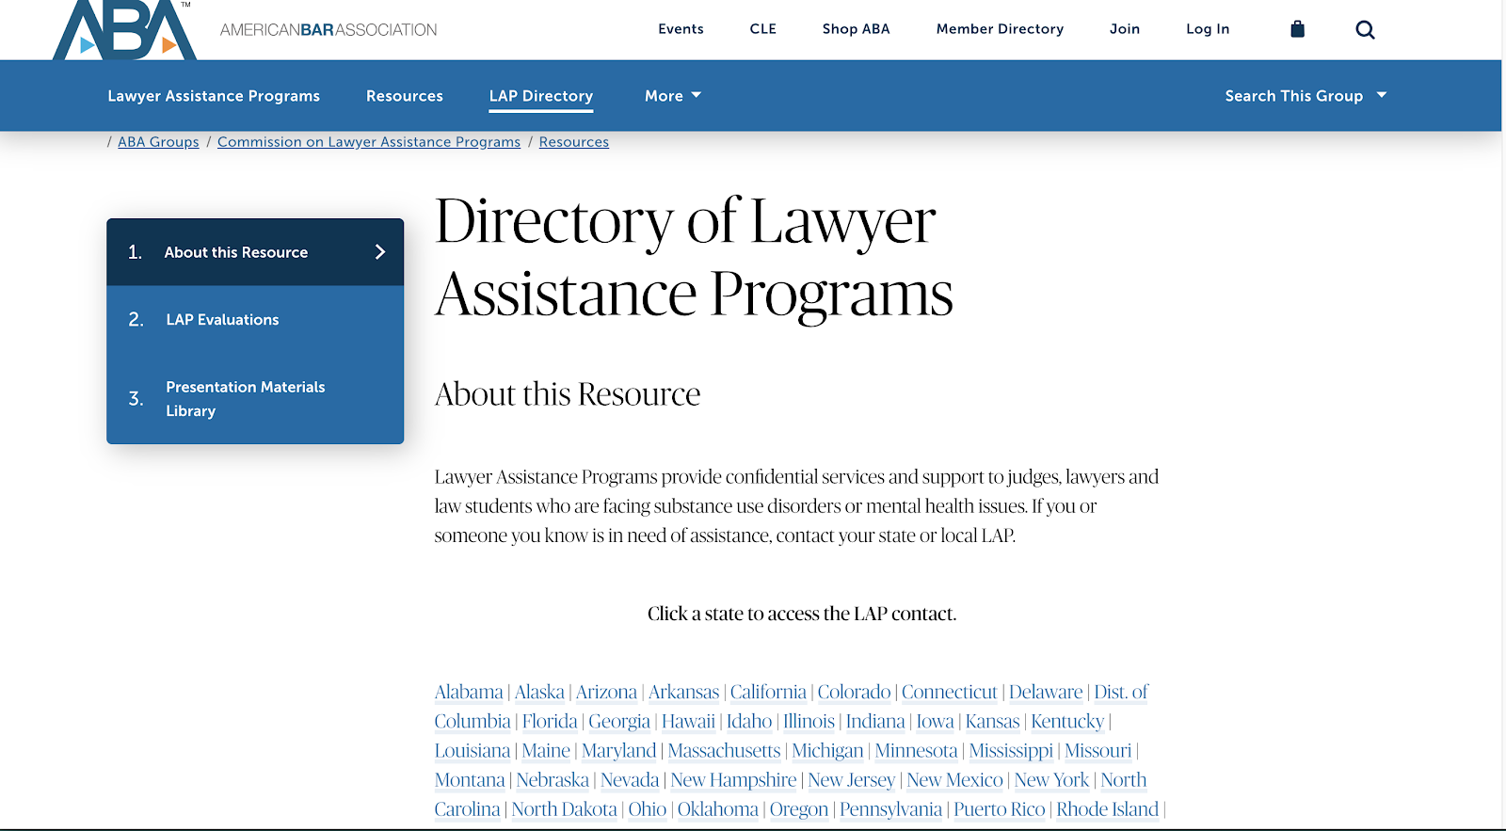
For Additional Assistance
The ABA study found many don’t seek help because
Denial about a problem
Afraid of being judged
Afraid it will harm professional reputation
Fear it will impact their license
Lawyer Assistance Programs, which provide confidential services and support to judges, lawyers and law students who are facing substance use disorders or mental health issues
Visit:
https://www.americanbar.org/groups/lawyer_assistance/resources/lap_programs_by_state/
Prosecutor Well-Being

Slide 9
Prosecutor Well-Being
Challenges unique to a prosecutor:
Given a lot of responsibility and autonomy with relatively little experience
Handling cases with difficult issues - rape, murder, child abuse
Working within the inherent inequities in the justice system
Decisions have an impact on others - people go to prison
Under-resourced / too many cases
Prosecutor Well-Being

Slide 10
“By the time you’re thirsty, you’re already dehydrated”
Van Dernoot Lipsky, 2009
Prosecutor Well-Being

Slide 11
What is “Well-Being”?
The ABA’s defines “well-being” as “A continuous process whereby lawyers seek to thrive in each of the following areas: emotional health, occupational pursuits, creative or intellectual endeavors, sense of spirituality or greater purpose in life, physical health and social connections with others.”
Preventative, rather than reactive
Prosecutor Well-Being

Slide 12
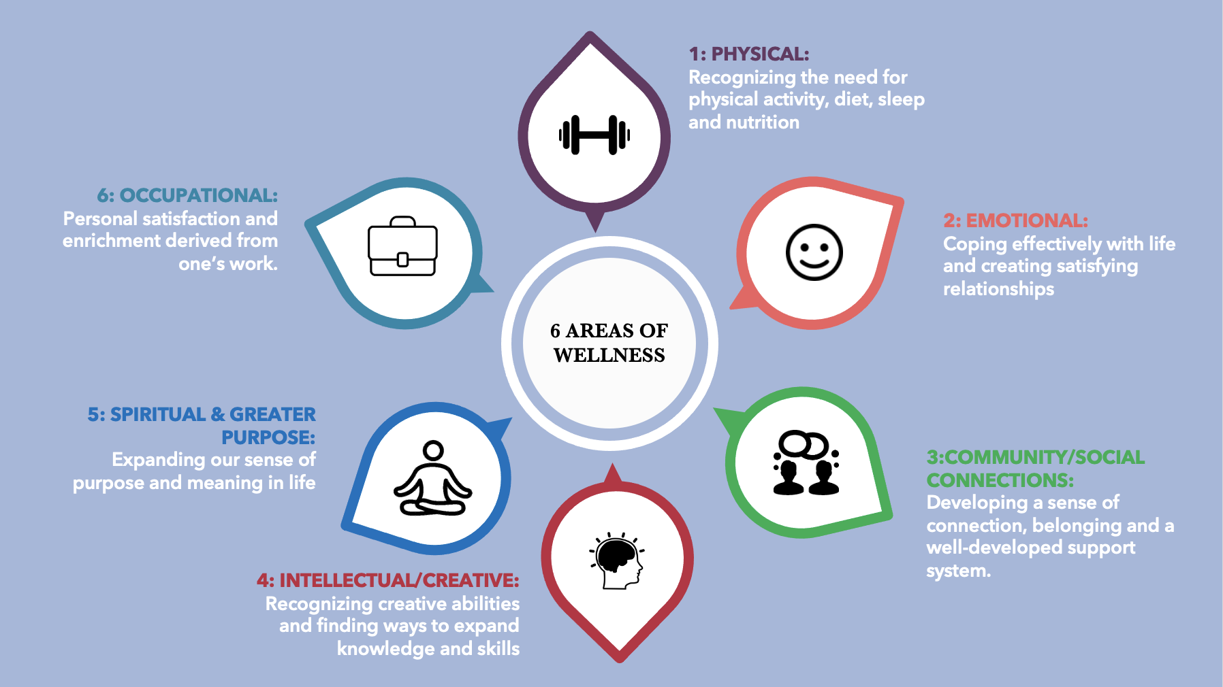
6 Areas of Well-Being
Physical health
Emotional health
Social connection/community
Creative and intellectual endeavors
Spirituality or purpose
Occupational pursuits
Prosecutor Well-Being

Slide 13
Well-Being and Prosecutors Ethical Responsibility
ABA Model Rules of Professional Conduct
Rule 1.1 (Competence): “A lawyer shall provide competent representation to a client. Competent representation requires the legal knowledge, skill, thoroughness and preparation reasonably necessary for the representation.”
Rule 1.3 (Diligence): “A lawyer shall act with reasonable diligence and promptness in representing a client.”
Prosecutor Well-Being

Slide 14
Well-Being and Prosecutors Ethical Responsibility cont’d
Prosecutors are public servants who must
Act with integrity and balanced judgment
Make impactful decisions
ABA Standard for the Prosecution Function 3-1.7(f): “The prosecutor should not permit the prosecutor’s professional judgment or obligations to be affected by the prosecutor’s personal . . . or other interests or relationships.”
Prosecutor Well-Being

Slide 15
Prosecutor Skill Set and Well-Being
Prosecuting effectively requires:
Effective advocacy
Public speaking requires mental focus and clarity
Communicating to juries
Competence in many “soft skills”
“Hold space for others”
People skills - connect with individuals from all walks of life
Civility and decency
Compassion and empathy
Prosecutor Well-Being

Slide 16
Neurobiology of Stress
Prosecutor Well-Being

Slide 17
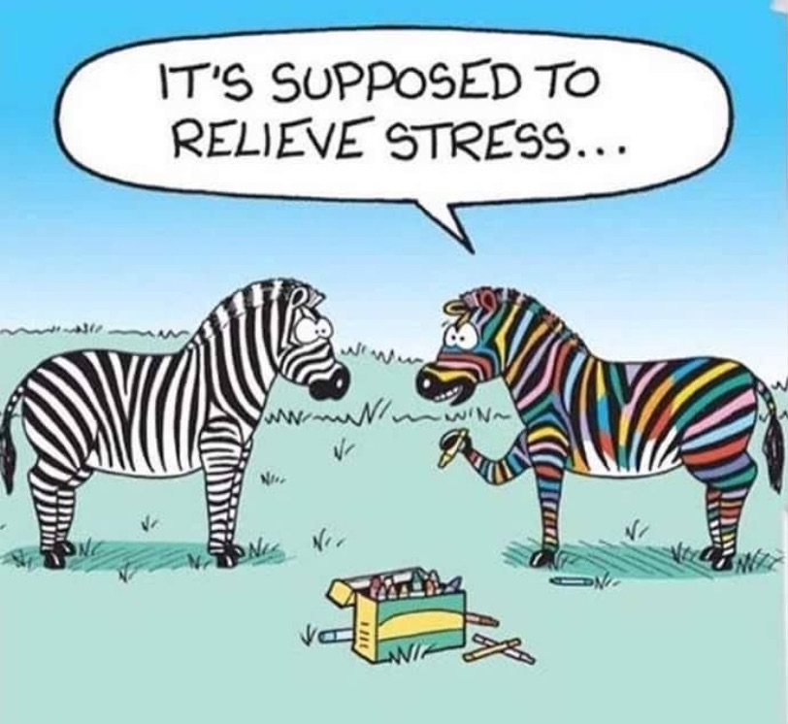
Prosecutors and Stress
Stress/ Chronic Stress:
“Zebras don’t get ulcers”
When we speak about stress with humans, it’s not typically because our life is threatened.
In addition, there is something unique about humans such that our thoughts can add to our stress.
Continued stress and the body being in that stress-response state does long term physical damage.
Prosecutor Well-Being

Slide 18
What is Trauma?
According to the Substance Abuse and Mental Health Services Administration:
“Individual trauma results from an event, series of events, or set of circumstances [one can suffer from all three at the same time; i.e. they may overlap and have a compounding effect] experienced by an individual as physically or emotionally harmful or life threatening with lasting adverse effects on the individual’s functioning and mental, physical, social, emotional, or spiritual well-being.”
Prosecutor Well-Being

Slide 19
Places Prosecutors Encounter Trauma
Interacting with crime survivors and witnesses
Interacting with family members of the deceased
Interacting with family members of those charged
Interacting with people charged with crimes
Sentencing - watching someone go to jail knowing you were part of it
Trial - interacting with jurors with trauma
Getting threatened - death threats/threats by family/ad hominem attacks in court
Media attention to work
Inherent bias + issues in criminal justice system
Inherent inequality in the system / lack of ability to do anything about it from an individual perspective
Having something happen to a victim you said you would protect
Going into the work to help people and harming / being seen as harming people
Dinner party - people’s response to your job
Prosecutor Well-Being

Slide 20
Working with Stress AND Trauma
Stressful events in life are inevitable and healthy amounts of stress can be positive and motivating
Excessive amounts of negative stress can wear down your body
Now compound that stress with working with traumatic content
Everyone is different in how they cope with/recover from traumatic stress. The individual is impacted by intrinsic factors and extrinsic factors:
Intrinsic: our biology, our personality, our abilities, any mental health issues, and previous trauma memories/coping skills that inform the present
Extrinsic: intergenerational histories, communal/familial support, access to therapeutic resources, access to basic resources, safety of environment, and the ability to ensure safety
Prosecutor Well-Being

Slide 21
Significant Consequences of Working with Stress and Trauma
According to William Steele in Reducing Compassion Fatigue, Secondary Traumatic Stress and Burnout, the following are 5 significant consequences of working with stress and trauma.
Burnout:
Happens over time in any work environment, based on exhaustion from work demands
Specific to work culture/practices
Increased risk for compassion fatigue
Compassion Fatigue (CF) (Originally coined in emergency rooms but expanded to a wide range of helping professions)
CF occurs over time where a person loses the ability to have compassion toward the people who they are helping, typically people who are traumatized or suffering
Prosecutor Well-Being

Slide 22
Significant Consequences of Working with Stress and Trauma cont’d
Secondary Traumatic Stress (STS): Triggered by direct/indirect exposure to trauma
Specific to those that work with the traumatized population, but does NOT meet full DSMV criteria of PTSD
May or may not co-exist with compassion fatigue and/or Secondary trauma
Vicarious Trauma (VT): similar to STS and coined around the same time, but includes the shift in world view
Specific to those that work with the traumatized population
STS + shift in worldview
Post-Traumatic Stress Disorder (PTSD): Triggered by direct/indirect exposure
Must meet all the following DSMV criteria: https://www.brainline.org/article/dsm-5-criteria-ptsd
*Please note: A diagnosis of any mental health disorder can only be made by a licensed professional.*
Prosecutor Well-Being

Slide 23
INTELLECTUAL/CREATIVE:
Diminished Creativity
Foggy thought process
Lack of organization
“As a prosecutor, why should I care?”
EMOTIONAL:
Uncomfortable feelings of guilt, fear, anger and cynicism
Dissociative moments / feeling detached
Feeling helpless/hopeless
Minimizing
Grandiosity
Avoidance
Intrusive thoughts
Numbing
PHYSICAL:
Chronic Exhaustion/Physical ailments
Substance Abuse/Addictions
6 AREAS OF WELLNESS
OCCUPATIONAL:
Sense of persecution - loss of sense of agency in one’s own life
Trouble with Decision Making
Missed Opportunities
COMMUNITY/SOCIAL CONNECTIONS:
Isolation
Inability to empathize
Strained (work and personal) relationships
Extreme concern for safety in relation to others
SPIRITUAL & GREATER PURPOSE:
A sense that one can never do enough
Negative world view
A loss of connection to living

Slide 24
Exercise
Why Did You Choose This Work?
Prosecutor Well-Being

Slide 25
Personal History, Culture, and Race
Consider how your own history of hardship, pain, suffering or trauma brought you to this work
Consider what ways your cultural history and race may impact your work
Reflect on how your own culture informs your beliefs on wellness. What are the cultural norms/beliefs you have around self care, wellness, or mental health? How do these beliefs impact the way you respond to stressors in your work and life?
Prosecutor Well-Being

Slide 26
Racialized Trauma and the Prosecutor Experience
Racialized trauma is embedded in every human due to the racist history of the world and our country. In fact, scientists have found that this intergenerational transmission of trauma has been transmitted through changes in epigenetics
Though individuals and their unique experiences contribute to one's ability to cope and heal from racialized intergenerational trauma, being aware of its presence can help you identify certain stressors on your wellness journey
The criminal justice system has a disparate and historical impact on communities of color. Prosecutors, particularly prosecutors of color, may have a complex relationship with their role in prosecuting cases
Prosecutor Well-Being

Slide 27
Prosecutorial Wellness and Culture
Culture and historic attitudes can contribute to a stressful environment.
Heavy caseloads, long hours and unpaid overtime
Age of workforce
Inherent work ethic that attracts people to the legal profession (i.e. typically hiring the top performing students)
Prevalence of alcohol at social events
Prosecutors are often applauded for being “tough minded”
There may be a culture that seeking help or showing vulnerability is considered weak
Prosecutor Well-Being

Slide 28
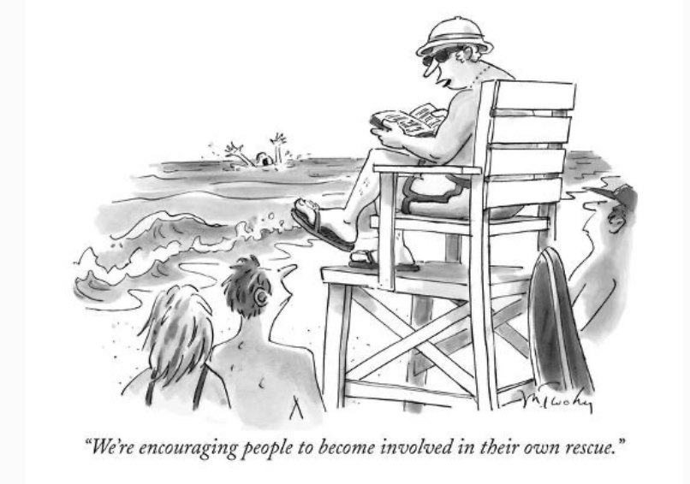
Prosecutorial Passion & Boundaries
Passion can help prosecutors perform well and enjoy their work.
Sometimes, however, prosecutors can be taken over by passion and lose sight of their role.
Being overtaken by prosecutorial passion is normal and expected. Any human being who is working with individuals who have been brutally victimized is susceptible to these strong emotions and biased tendencies. Awareness is the first step in balancing prosecutorial passion.
Prosecutors must check in with themselves and evaluate the boundaries they have between themselves and the case/crime survivor/victim’s family/and defendant.
Prosecutor Well-Being

Slide 29
6 Areas of
Wellness
Prosecutor Well-Being

Slide 30
1: PHYSICAL:
Recognizing the need for physical activity, diet, sleep and nutrition
6: OCCUPATIONAL:
Personal satisfaction and enrichment derived from one’s work.
2: EMOTIONAL:
Coping effectively with life and creating satisfying relationships
6 AREAS OF WELLNESS
5: SPIRITUAL & GREATER PURPOSE:
Expanding our sense of purpose and meaning in life
3:COMMUNITY/SOCIAL CONNECTIONS:
Developing a sense of connection, belonging and a well-developed support system.
4: INTELLECTUAL/CREATIVE:
Recognizing creative abilities and finding ways to expand knowledge and skills
Prosecutor Well-Being

Slide 31
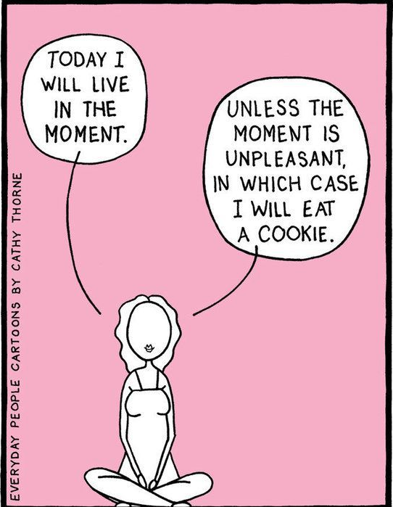
No One Solution
“Wellness is not a state of being, but a state of action”
Nagoski & Nagoski, 2020
Prosecutor Well-Being

Slide 32
Goals
The goals of integrating processes into your life that enhance well-being include:
Do your job more efficiently
Improve job performance by improving overall happiness
Prevent burnout
Support your physical health
Reduce instances of addiction
Cultivate time + presence
Enhance relationships
Prosecutor Well-Being

Slide 33
Physical Health
Physical health includes
Caring for and being in touch with the the physical body
Connecting with the breath
Diet/nutrition
Sleep/rest
The stress response causes the body to go into fight, flight, or freeze. Prolonged states in
stress response can cause these hormones to remain elevated, leading to negative long term
health outcomes. For example:
Anxiety/depression
Digestive problems
Heart disease
Sleep problems
Prosecutor Well-Being

Slide 34
Physical Health Practices
Small acts that are kind to the body:
Drink water
Limit intake of substances (sugar, caffeine, alcohol, TV, social media)
Incorporate physical activity / move your body (walk, run, dance, yoga)
Pay attention to your breath
Regularly complete the stress cycle (Nagoski & Nagoski, 2020).
Prosecutor Well-Being

Slide 35
Emotional Health
Mental health
Feeling joy, fear, anger, disgust --- provide information
Your emotions are this incredible radar system that you can build with – use it!
Relationships (family, significant other, friendships)
Emotional intelligence
Resilience
Why is this important?
To be human, is to experience emotions
To create a rich and meaningful life with yourself and others
Emotions are not “bad”
Numbing out emotion numbs out all emotions
Prosecutors are often encouraged to operate without emotion about their cases
Prosecutor Well-Being

Slide 36
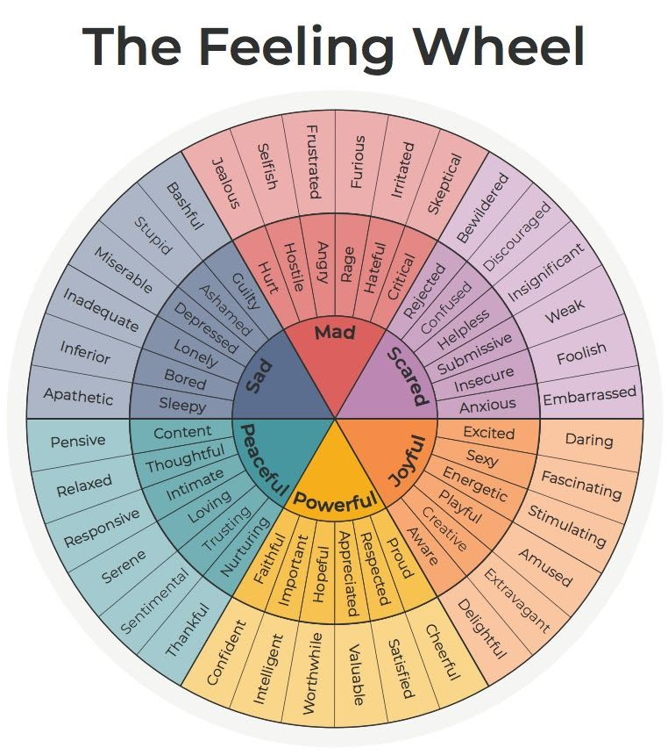
Emotional Health Practices
Self study
Pay attention to where you feel emotions in your physical body
Use a feeling wheel to identify words (see image):
https://cdn.gottman.com/wp-content/uploads/2020/04/The-Gottman-Institute The-Feeling-Wheel.pdf
Admitting and practicing vulnerability
Journaling
Meditation
Address perfectionism
Check in on all/nothing thinking
Practice dialectics (holding 2 opposite concepts at the same time)
Practice mindfulness
Prosecutor Well-Being

Slide 37
Community/Social Connections
The need for community, connection to others and a sense of belonging is paramount
Isolation and loneliness are not good for overall well-being
Completing the stress cycle can be done by positive social interaction or affection with a person that you trust and feel safe with, such as a 6 second kiss/20 second hug (Nagoski & Nagoski, 2020).
Prosecutor Well-Being

Slide 38
Community/Social Connections Practices
Take stock of communities you belong to
Join + contribute to groups
Cultivate your community + reliable support network
Check your social media use
Spend time disconnected from your phone
Prosecutor Well-Being

Slide 39
Creative/Intellectual Endeavors
Diminished creativity can be a trauma exposure response.
Prosecutor Well-Being

Slide 40
Creative/Intellectual Practices
Make time to do something creative that you feel drawn to -- write, draw, paint, dance
Read
Play
Take time off
Move your body
Seek out new experiences
Prosecutor Well-Being

Slide 41
Spirituality/Greater Purpose
A sense of purpose or meaning in life, as sense of connection to something greater, and/or a sense that we are all connected.
“He who has a why to live for can bear with almost any how”
Friedrich Nietzsche
Prosecutor Well-Being

Slide 42
Spirituality/Greater Purpose Practices
Get closer to nature - take a walk in the woods, pet an animal, watch a sunrise or sunset
Practice curiosity
Consider alternative perspectives
Meditate
Prosecutor Well-Being

Slide 43
Occupational Pursuits
Personal satisfaction and enrichment derived from one’s work
Work v. job
Consider finances and savings
Consider future employment options
Ask yourself why you are doing this job
Are you taking actions that are moving you toward your values or away from them (Harris, 2019)?
Prosecutor Well-Being

Slide 44
Occupational Pursuits Practices
Do a self-evaluation - what am I passionate about and what is my job
Do a skills evaluation - what skills do I have that other people don’t, what is easy for me?
Network with people outside of the office, learn about other ways to use your skills
Attend trainings and lectures to learn about other lines of work
Cultivate mentors
Prosecutor Well-Being

Slide 45
Suggestions for Prosecutors’ Offices
Enlist leaders
Launch a well-being committee
Identify needs within your office
Create an action plan to support employee well-being
Create a community where employees feel supported
Devote resources and policy decisions to culture improvement in your office
Support employees with substance abuse and mental health issues
Attract a diverse workforce
Continually evaluate, measure and improve
Prosecutor Well-Being

Slide 46
List Your Office Resources Here
Prosecutor Well-Being

Slide 47
“Yesterday I was clever, so I wanted to change the world. Today I am wise, so I am changing myself.”
Rumi

